Slide 1





HANDS-ON CHALLENGE
Deploy Web Application
On EC2
Day 7 - #Cloud_Learning_Challenge
Page 01

Slide 2
ROAD MAP
Basics of Web Servers
Why we require EC2 Instances
How to create and setup EC2 Instance
What is a reverse proxy
Setting up Nginx
Setting up Demo Flask Server
Run Flask Server in Background
SSL Certificate
Page 02

Slide 3
What is
WEB-SERVER?
A web server is simply a program that binds to an IP address and port and passively listens for the incoming requests from clients (like web browsers, mobile apps, other servers, etc. )
When a request arrives, the web server processes the request and then sends back the response as web pages, APIs or other content.
Ports 0-1023 are called "privileged ports" because they are assigned to well-known services. You need to provide administrative privilege for a service to listen on these ports
By Default,
HTTP – PORT 80
HTTPS – PORT 443
Page 03

Slide 4
What is
WEB-SERVER?
What Happens When You Type http://example.com in a Browser?
Your browser sends a request to example.com.
Since no port is specified, the browser assumes Port 80 (for HTTP).
The program at example.com is listening on Port 80 and responds with the requested webpage.
What Happens When You Type https://example.com?
The browser knows HTTPS should use Port 443 by default.
The request goes to example.com on Port 443.
The server responds securely with encrypted data.
What if You Use a Custom Port? (http://example.com:5000)
The request is sent to example.com on Port 5000, instead of the default 80.
If no application is listening on Port 5000, the request will fail.
Page 04

Slide 5
Why we require
EC2 Instances (VMs) for Deployment?
VMs give you full control over the entire stack, from the operating system to the application layer. This level of control can be necessary for fine-tuning performance, security, and other aspects of the application.
Application may involve long-running tasks or background processes that are not well-suited to the ephemeral nature of serverless functions.
Application may require specific operating systems, libraries, or configurations that are not supported by serverless platforms.
Application has consistent, predictable workloads that require dedicated resources (CPU, RAM, etc.).
Page 02

Slide 6
Setting up our EC2 Instance
Page 02

Slide 7
Setting up the Flask Server
Page 02

Slide 8
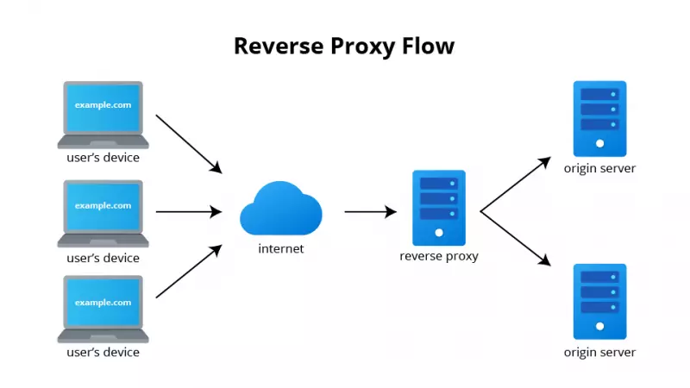
Reverse Proxy
A reverse proxy is a server that sits between client devices (e.g., web browsers) and backend servers (e.g., Flask, Express, or other application servers). It acts as an intermediary, forwarding client requests to the appropriate backend server and returning the server's response to the client.
Popular reverse proxy servers include Nginx, Apache HTTP Server, and Caddy.
Page 02

Slide 9
Why We Need Reverse Proxy
Security:
Acts as a shield for backend servers, hiding their identities and protecting them from direct exposure to the internet.
Routing to different services:
Routes requests to different backend servers based on the URL or other criteria.
Load Balancing:
Distributes incoming traffic across multiple backend servers to ensure no single server is overwhelmed.
Caching:
Stores static content (e.g., images, CSS, JavaScript) or even dynamic content to reduce load on the backend server.
Page 02

Slide 10

Imagine you just clicked "Play" on Netflix. Where do you think the movie is actually stored?
A) On your device
B) On Netflix’s office servers
C) On cloud servers distributed worldwide
D) I have no idea, I just want to watch my movie!
Page 02

Slide 11

What is
CLOUD COMPUTING ?
Cloud Computing refers to the delivery of computing services—including servers, storage, databases, networking, software, and analytics—over the internet ("the cloud") to offer faster innovation and flexible resources.
Key Characteristics:
On-demand self-service
Broad network access
Resource pooling
Rapid elasticity
Pay-as-you-go pricing
Page 03

Slide 12

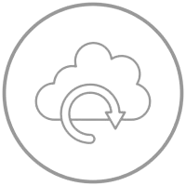
Benefits of
CLOUD
Cost-Efficiency
Disaster Recovery
One of the most significant benefits of cloud computing is cost reduction. Organizations can avoid the high upfront costs of purchasing and maintaining on-premise servers, networking equipment, and software licenses. With a pay-as-you-go model, businesses only pay for the resources they use, making it highly cost-effective. Additionally, cloud providers handle maintenance and security, reducing IT overhead
Cloud computing provides robust disaster recovery (DR) and backup solutions that ensure data availability, integrity, and resilience against failures. Traditional disaster recovery solutions required businesses to maintain redundant physical infrastructure, which was expensive and complex. Cloud-based solutions eliminate these challenges by offering automated, scalable, and cost-effective disaster recovery mechanisms.
Page 04

Slide 13
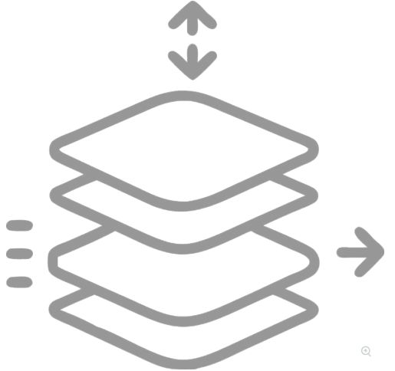

Benefits of
CLOUD
Scalability and Elasticity
Flexibility & Accessibility
Cloud platforms offer dynamic scalability, enabling businesses to scale their computing resources up or down based on demand. This ensures optimal resource utilization and cost savings. Vertical scaling allows for increasing the power of a single resource, while horizontal scaling enables adding multiple resources to handle growing workloads. This flexibility is essential for handling sudden spikes in traffic or business growth.
Cloud computing allows users to access data, applications, and services from anywhere with an internet connection. It supports remote work, real-time collaboration, and business continuity. Employees can securely access company systems from multiple devices without being restricted to a physical location. This flexibility enhances productivity and ensures seamless operations regardless of geographic constraints.
Page 05

Slide 14

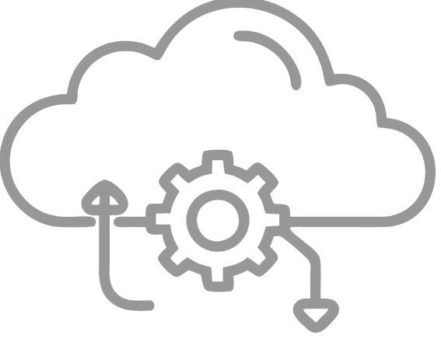
Benefits of
CLOUD
Security & Compliance
Maintenance
Cloud providers implement enterprise-grade security measures, including data encryption, multi-factor authentication, firewalls, and continuous threat monitoring. Regular security updates ensure protection against vulnerabilities. Compliance with industry standards and regulations such as GDPR, HIPAA, and ISO 27001 guarantees that businesses meet legal and security requirements, reducing risks associated with data breaches and cyberattacks.
With cloud computing, software updates, security patches, and system maintenance are handled automatically by service providers. This eliminates downtime caused by manual updates and ensures that businesses always run on the latest, most secure versions of their applications and infrastructure. IT teams can focus on innovation and business growth instead of routine maintenance tasks.
Page 06

Slide 15

BIG PLAYERS IN
CLOUD
Top Cloud Providers:
Amazon Web Services (AWS) – Largest market share
Microsoft Azure – Popular in enterprise IT
Google Cloud Platform (GCP) – Strong in AI and analytics
IBM Cloud & Oracle Cloud – Focus on enterprise and database solutions
Page 07

Slide 16



CLOUD
Deployment Models
PUBLIC CLOUD
PRIVATE CLOUD
HYBRID CLOUD
It is accessible to the public. Public deployment models in the cloud are perfect for organizations with growing and fluctuating demands. It also makes a great choice for companies with low-security concerns. Thus, you pay a cloud service provider for networking services, compute virtualization & storage available on the public internet. Its configuration and deployment are quick and easy, making it an ideal choice for test environments.
Companies that look for cost efficiency and greater control over data & resources will find the private cloud a more suitable choice. It means that it will be integrated with your data center and managed by your IT team. Alternatively, you can also choose to host it externally. The private cloud offers bigger opportunities that help meet specific organizations' requirements when it comes to customization.
As the name suggests, a hybrid cloud is a combination of two or more cloud architectures. While each model in the hybrid cloud functions differently, it is all part of the same architecture. Further, as part of this deployment of the cloud computing model, the internal or external providers can offer resources. A company with critical data will prefer storing on a private cloud, while less sensitive data can be stored on a public cloud.
Page 08

Slide 17
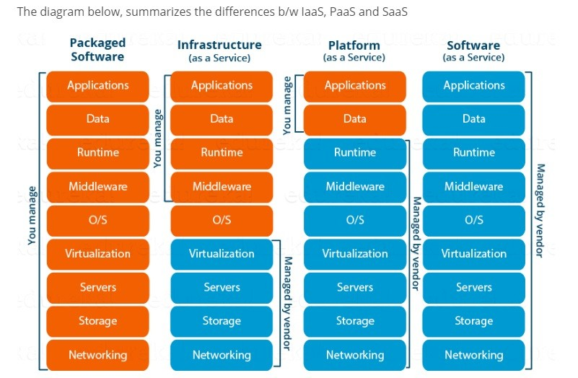
CLOUD
Service
Model
Page 09
APPLICATION
DATA
RUNTIME
MIDDLEWARE
O/S
VIRTUALIZATION
SERVERS
STORAGE
NETWORKING

Slide 18
APPLICATION
Infrastructure
DATA
As a
Service
RUNTIME
MIDDLEWARE
IaaS, or Infrastructure as a Service, is a cloud computing model that provides on-demand access to computing resources such as servers, storage, networking, and virtualization. IaaS allows business to outsource their whole IT infrastructure to a cloud service provider, empowering them to arrange, deploy, and manage computing resources on-demand
O/S
VIRTUALIZATION
SERVERS
STORAGE
NETWORKING
Page 10

Slide 19
APPLICATION
Platform
DATA
As a
Service
RUNTIME
MIDDLEWARE
O/S
Platform as a Service (PaaS) is a cloud computing model that provides a managed environment with infrastructure, runtime, and development tools, allowing developers to build, deploy, and manage applications without handling underlying hardware.
VIRTUALIZATION
SERVERS
STORAGE
NETWORKING
Page 11

Slide 20
APPLICATION
Software
DATA
As a
Service
RUNTIME
MIDDLEWARE
O/S
Software as a Service (SaaS) in AWS is a cloud computing model where AWS hosts and manages software applications, making them accessible to users over the internet. It eliminates the need for infrastructure management, providing automatic updates, scalability, and a pay-as-you-go pricing model.
VIRTUALIZATION
SERVERS
STORAGE
NETWORKING
Page 06

Slide 21
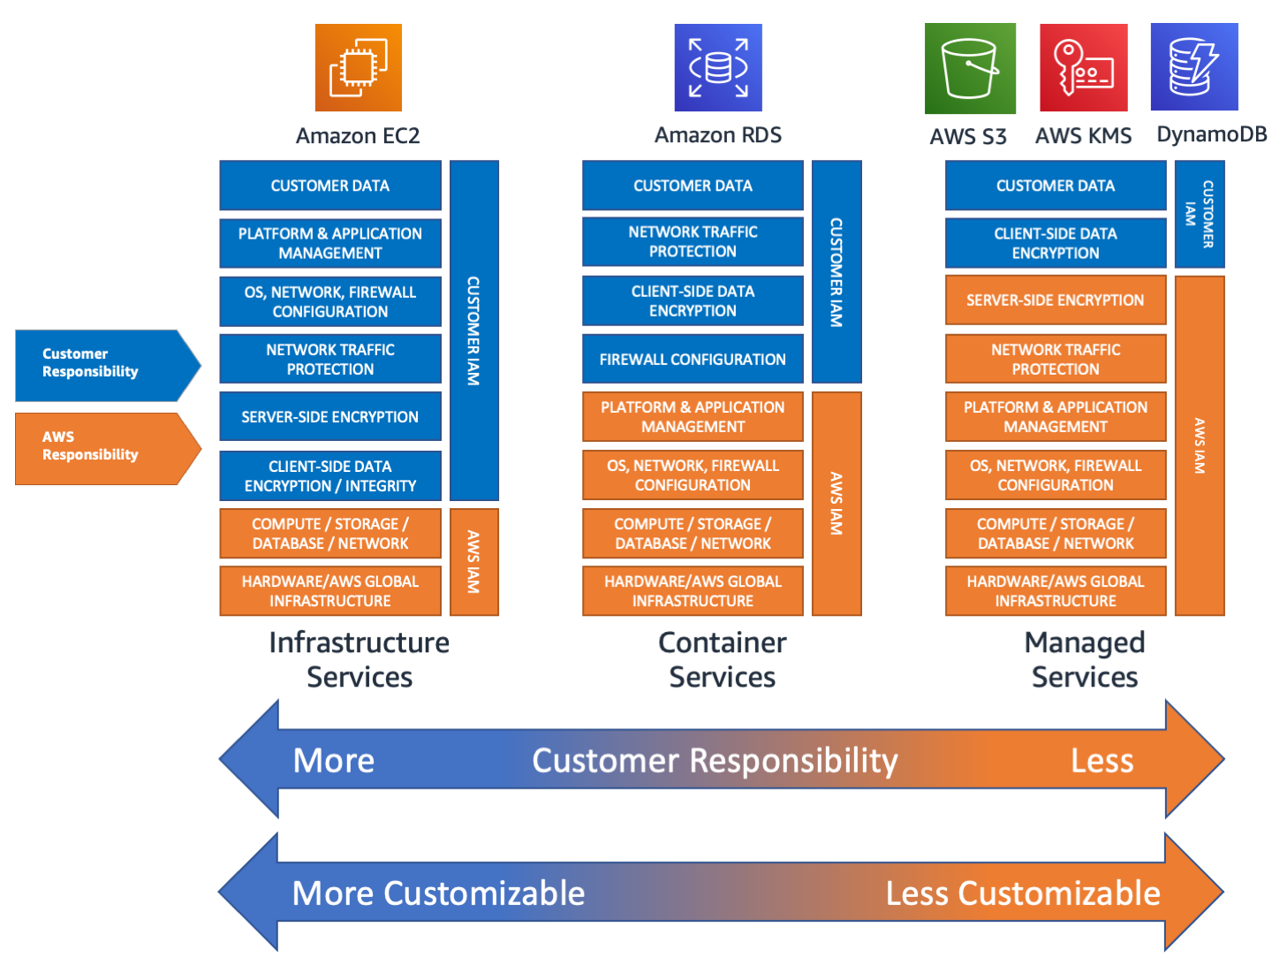
Shared
Responsibility
Model
Page 12

Slide 22
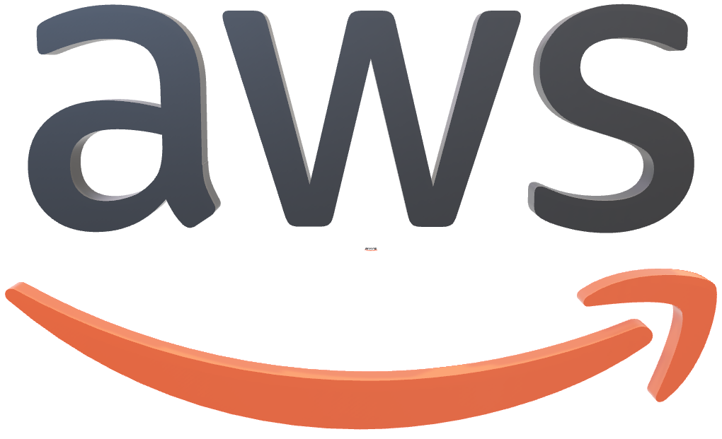
Intro to
Amazon Web Services
Amazon Web Services (AWS) is a leading cloud computing platform that provides a wide range of services, including computing power, storage, databases, networking, artificial intelligence, and security. Launched by Amazon in 2006, AWS allows businesses and individuals to build, deploy, and manage applications without needing physical infrastructure.
Page 13

Slide 23
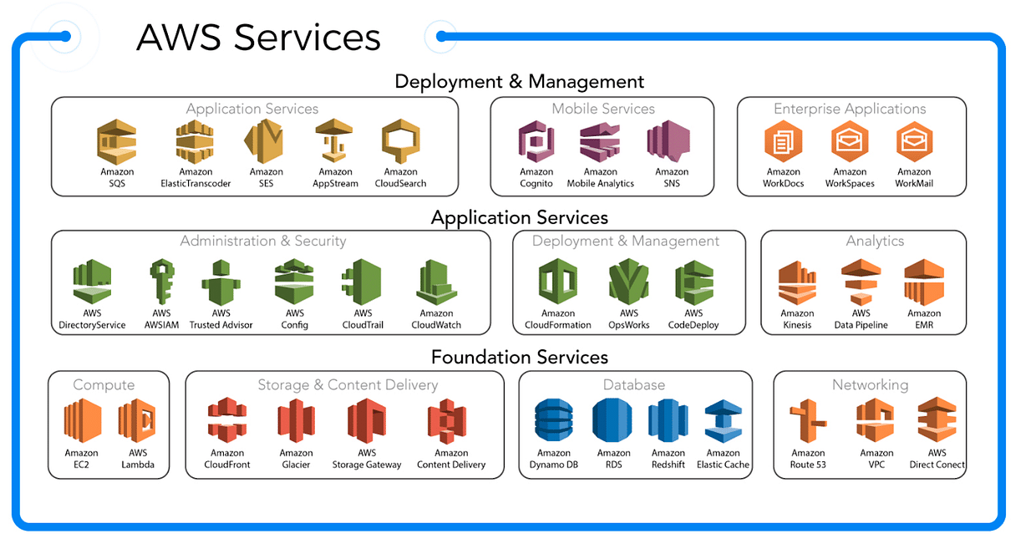
AWS
Services & Category
Page 14

Slide 24
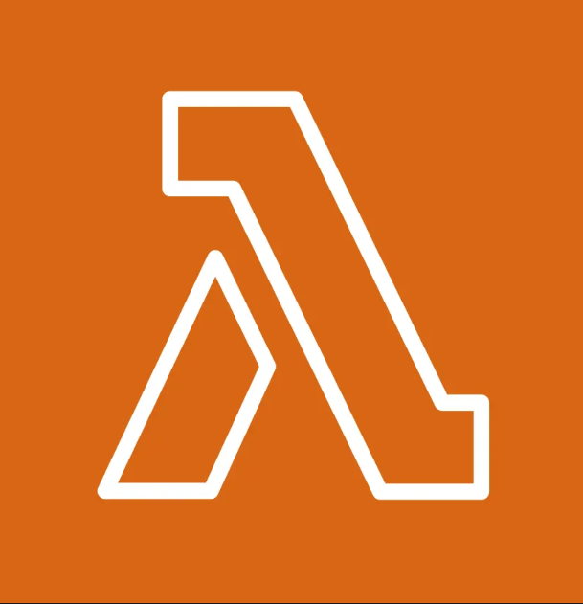

AWS
Compute Services
EC2
AWS Lambda
Elastic Compute Cloud provides resizable virtual machines in the cloud. It allows users to run applications on customizable compute capacity with various instance types.
A serverless compute service that runs code in response to triggers without provisioning or managing servers. It automatically scales and charges only for execution time.
Page 15

Slide 25
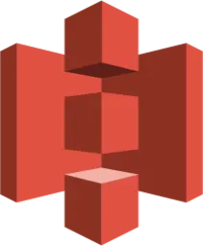

AWS
Storage Services
S3 Storage
AWS EBS
Simple Storage Service provides highly scalable, durable, and secure object storage for any type of data. It supports data backup, archiving, and content distribution.
Elastic Block Store provides persistent block storage for EC2 instances. It offers high availability, snapshots, and encryption for secure data storage.
Page 16

Slide 26


AWS
Database Services
AWS RDS
DynamoDB
A managed relational database service supporting multiple engines like MySQL, PostgreSQL, and SQL Server. It automates database tasks like provisioning, backups, and scaling.
A fully managed NoSQL database that delivers single-digit millisecond performance at any scale. It supports key-value and document data models with built-in security and backup.
Page 17

Slide 27

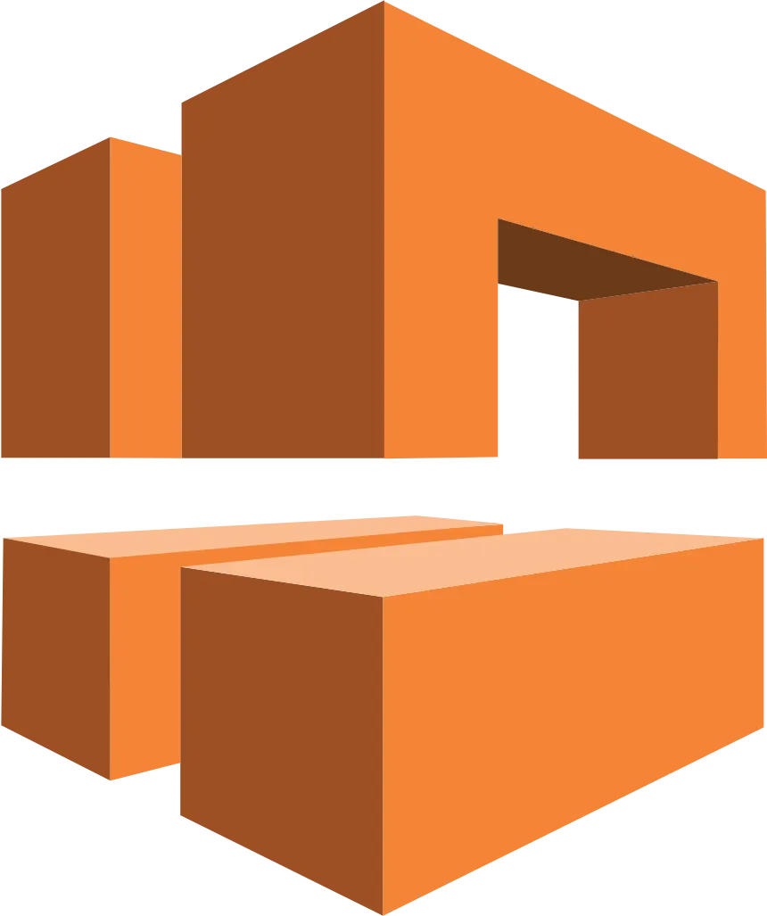
AWS
Networking Services
Route 53
VPC
A scalable and highly available DNS and domain name registration service. It enables traffic routing, health checks, and domain management.
Virtual Private Cloud allows users to create isolated network environments in AWS. It provides control over IP addressing, subnets, and network security.
Page 18

Slide 28


AWS
Security Services
IAM
AWS Shield
Identity and Access Management enables secure access control to AWS resources. It allows users to define policies, roles, and permissions for fine-grained security.
A managed DDoS protection service that safeguards AWS applications against attacks. It provides automatic detection and mitigation to ensure application availability.
Page 19

Slide 29


Time for QnA
Ask away!!!
Page 20

Slide 30
THANK YOU
Page 21

